Slide 1
Single Lead to 12 Lead ECG using DL(RNN)
Sravanth CS20b1006
Jathin CS20b1092
Chandulal EC21B1031

Slide 2
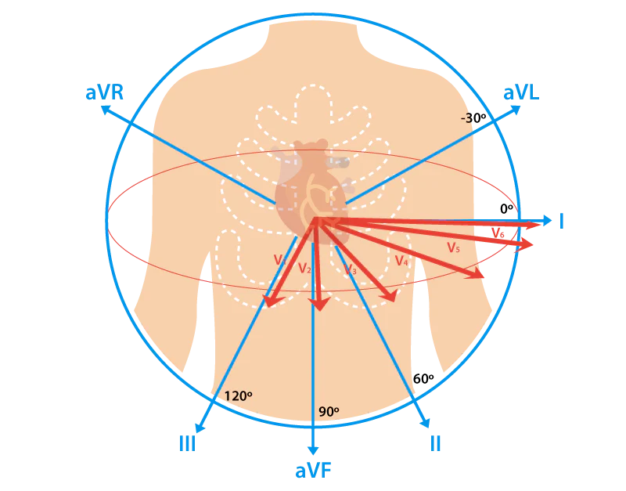
Introduction And Problem Statement
Background: Electrocardiography (ECG) is essential for diagnosing cardiovascular diseases.
Current Challenge: Often only limited ECG data (e.g., one lead) is available, especially in remote or emergency settings, limiting diagnostic capabilities.
Project Objective: Use LSTM models to generate the complete set of 12-lead ECG data from the data captured from a single lead (Lead I).
Significance: This approach aims to enhance ECG monitoring under constraints, enabling comprehensive cardiac analysis from minimal data, thereby improving patient care in diverse settings.
12 Lead ECG Chart

Slide 3
Literature Survey
Lee, Hong J., et al. "Reconstruction of 12-lead ECG Using a Single-patch Device." Methods of Information in Medicine 56.04 (2017): 319-327.
Sohn, Jangjay, et al. "Reconstruction of 12-lead electrocardiogram from a three-lead patch-type device using a LSTM network." Sensors 20.11 (2020): 3278.
I. Tomašić and R. Trobec, "Electrocardiographic Systems With Reduced Numbers of Leads—Synthesis of the 12-Lead ECG," in IEEE Reviews in Biomedical Engineering, vol. 7, pp. 126-142, 2014, doi: 10.1109/RBME.2013.2264282.
Datasets Available : PTB-XL, KURIAS-ECG

Slide 4
LSTM ALREADY USED IN ECG’s
Zhu, F., Ye, F., Fu, Y. et al. Electrocardiogram generation with a bidirectional LSTM-CNN generative adversarial network. Sci Rep 9, 6734 (2019). https://doi.org/10.1038/s41598-019-42516-z
A. Kapfo, S. Datta, S. Dandapat and P. K. Bora, "LSTM based Synthesis of 12-lead ECG Signal from a Reduced Lead Set," 2022 IEEE International Conference on Signal Processing, Informatics, Communication and Energy Systems (SPICES), THIRUVANANTHAPURAM, India, 2022, pp. 296-301, doi: 10.1109/SPICES52834.2022.9774204. Used 3 Leads
Zacarias, Henriques, et al. "ECG Forecasting System Based on Long Short-Term Memory." Bioengineering 11.1 (2024): 89

Slide 5

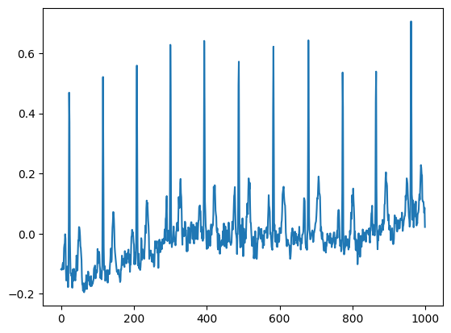
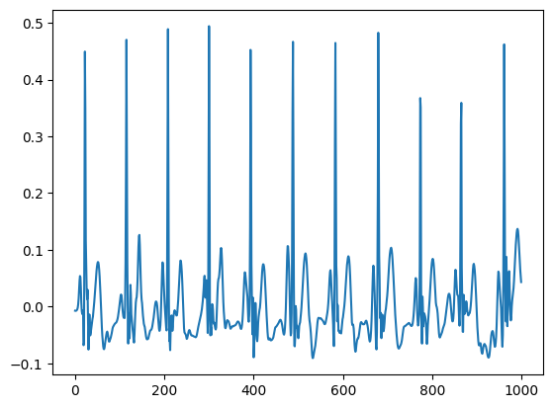
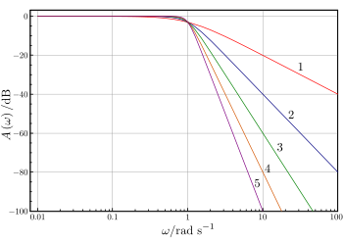
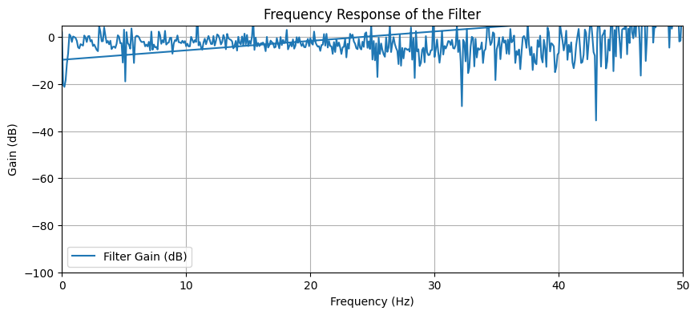
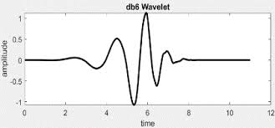
Methodology – Noise Removal
Noisy Signal
Denoised Signal
Used Butterworth filter and discrete wavelet transform to remove the low frequency(baseline wander) and high frequency noise in the signal
Butterworth Filter
Frequency Response
DB-6 Wavelet

Slide 6
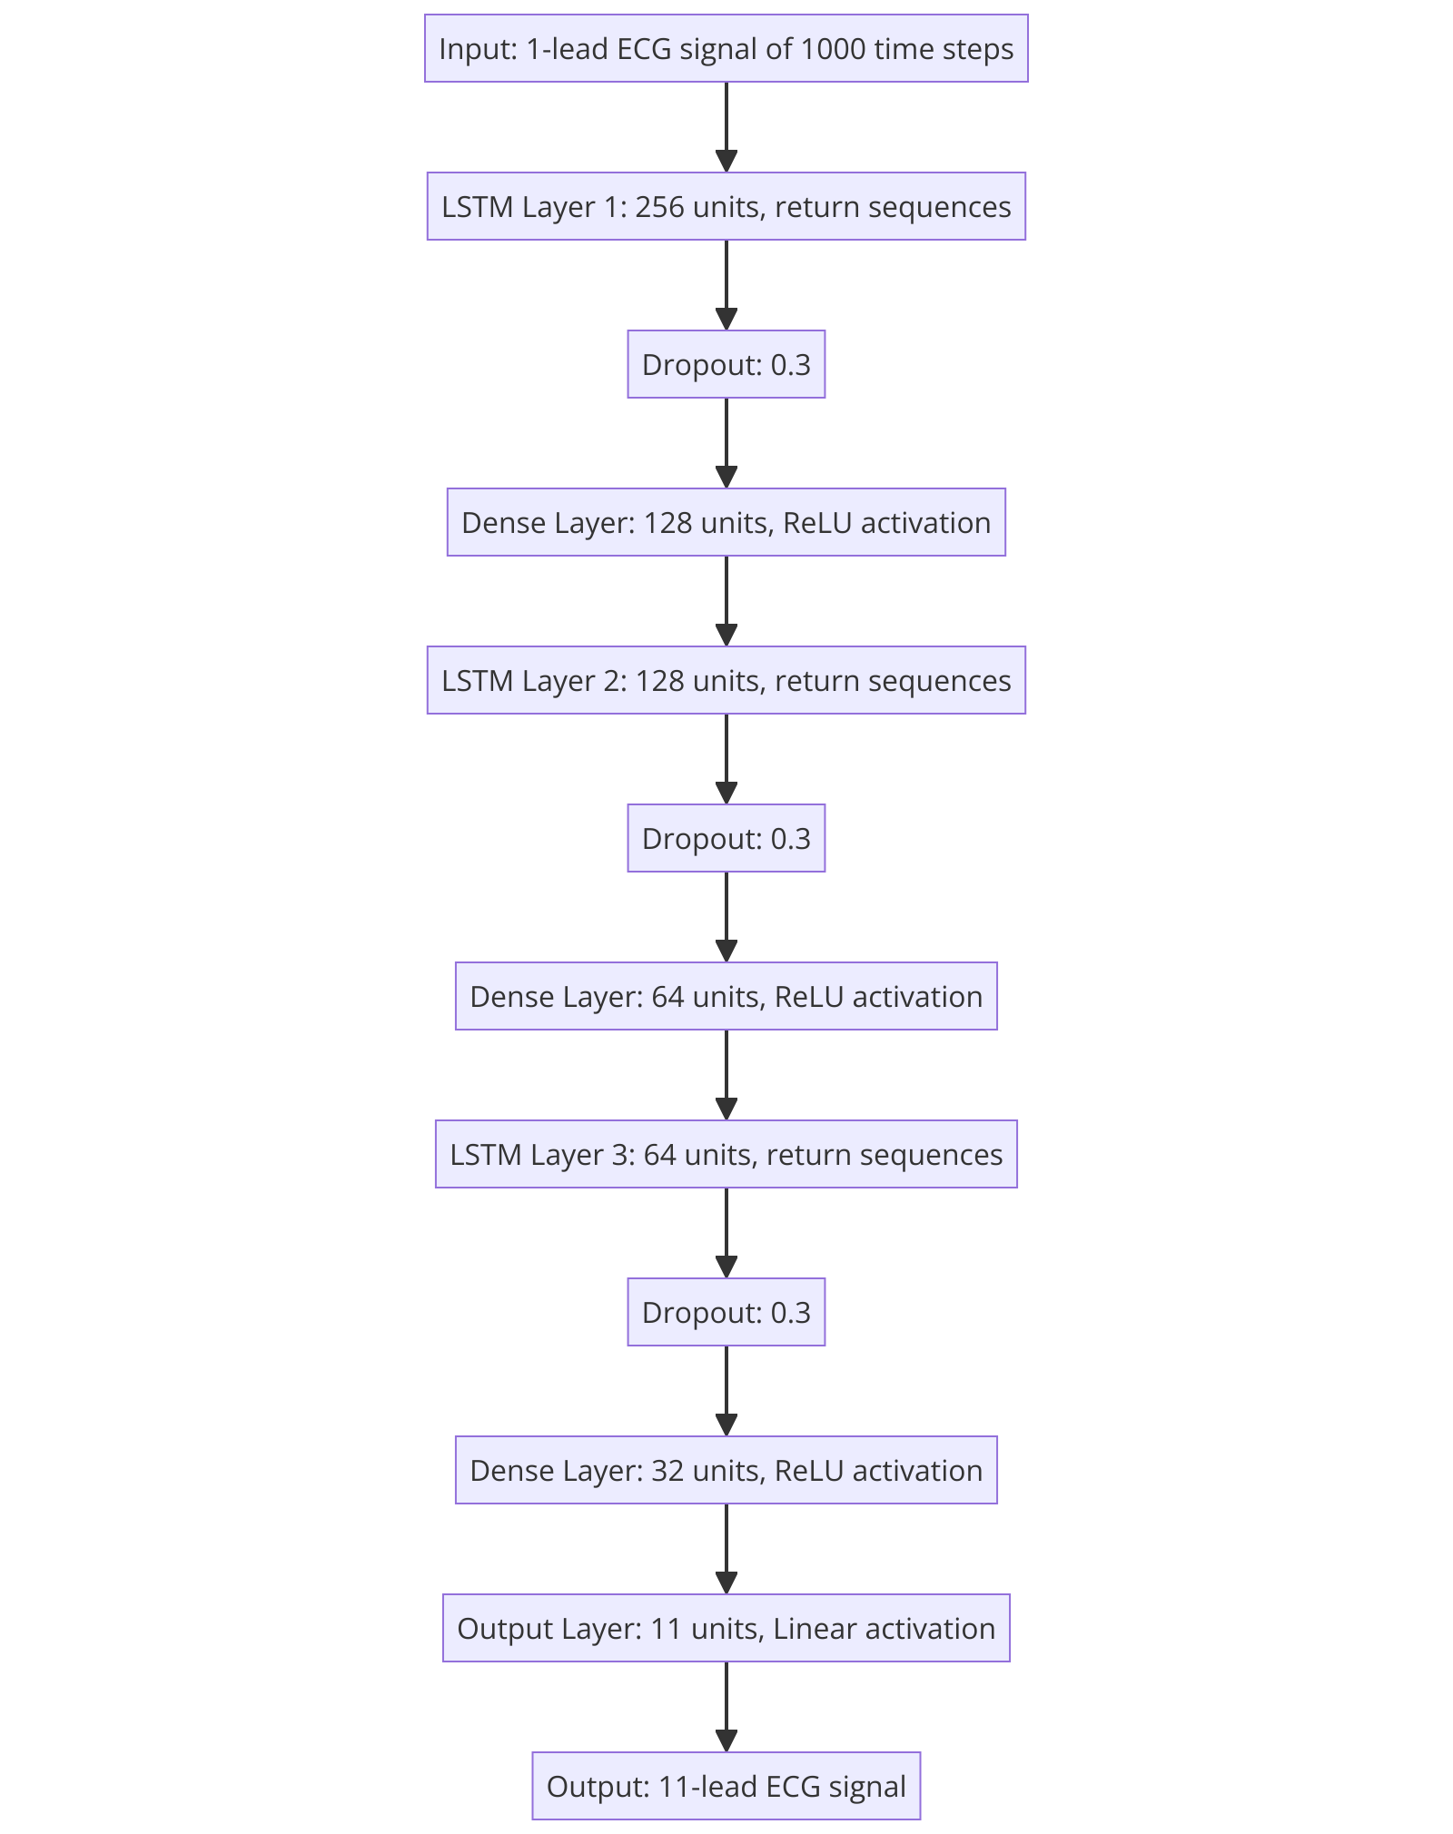
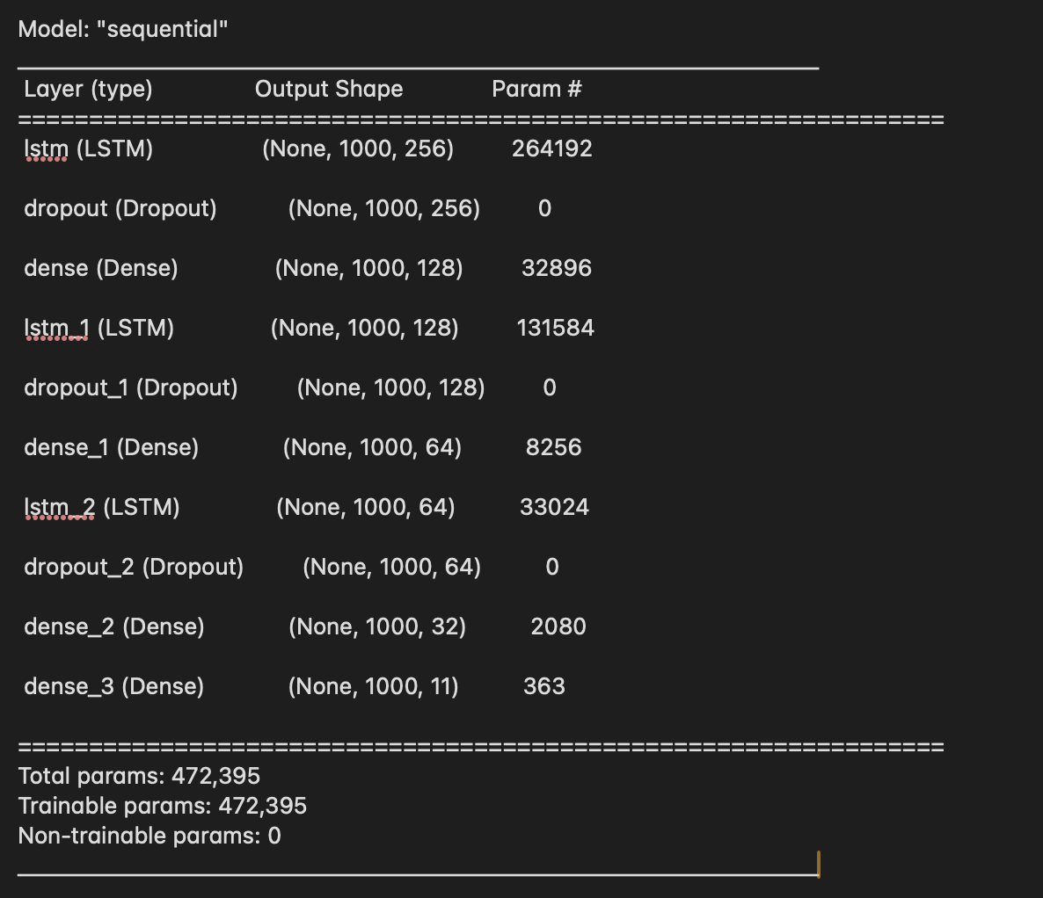
Methodology – Model Training And Evaluation
Experimented with multiple single input LSTM Models with and without noise removal and evaluated the model using evaluation metrics such as Pearson correlation coefficient and r2 score.
Shown is the best performing model according to our evaluation metrics with peak correlation coefficient of 0.9 in lead 4 and 5 and an r2 score of 0.56
LSTM Neural Network Representation

Slide 7
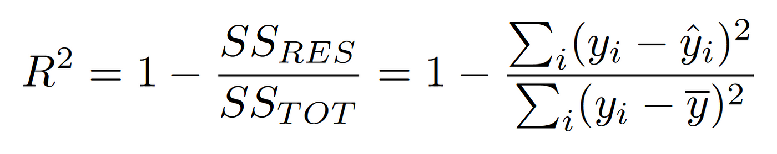
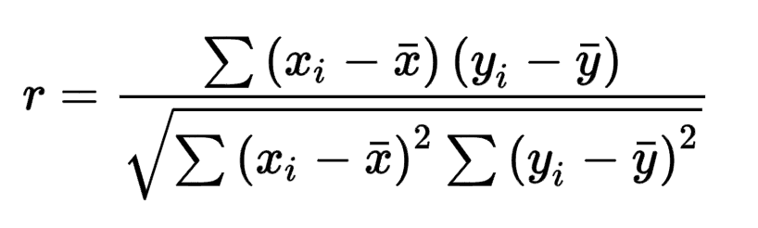
Results AND Metrics
R² Score: It measures how well a regression model predicts the actual values, with 0 indicating no predictive power and 1 indicating perfect prediction.
Pearson Correlation: It quantifies the strength and direction of a linear relationship between two variables, ranging from -1 (perfect negative correlation) to +1 (perfect positive correlation).
R2 Score
Pearson Correlation Coefficient

Slide 8
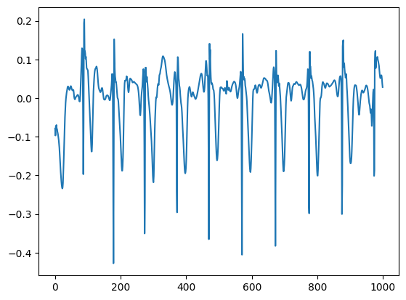
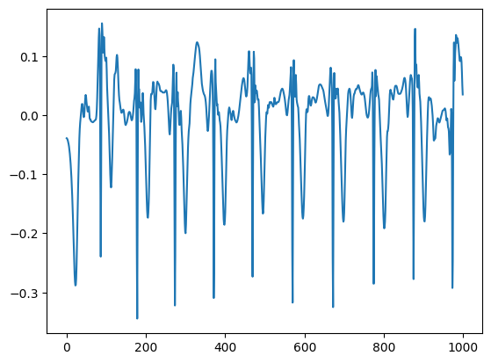
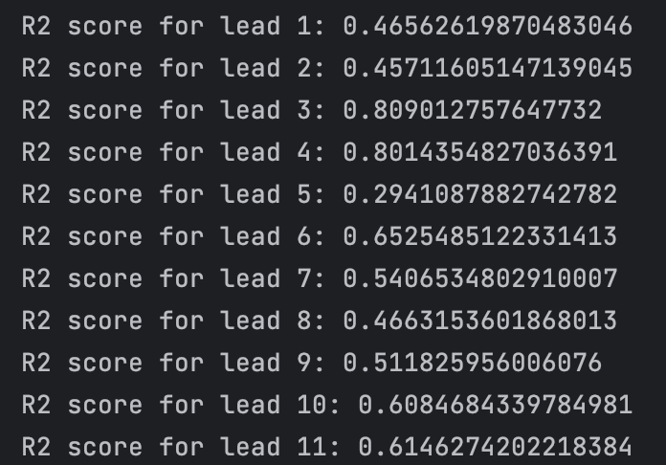
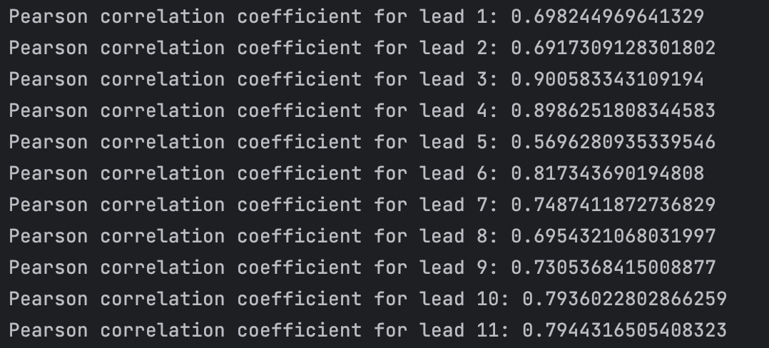
Results
Actual And Reconstructed Signals
Shown in the image is the pearson correlation coefficient and R2 Scores for the remaining 11 leads for our best performing model
R2 Scores of the models:
Without Noise Removal : 0.42
Simple Model With Noise Removal : 0.53
Medium Sized Model With Noise Removal : 0.54
Large Model With Noise Removal : 0.56
R2 Scores and Pearson Correlation Of The Leads

Slide 9
Conclusion
Experimented in training the PTB-XL dataset with models of various sizes with and without noise removal and achieved promising results for the regeneration of the ECG signal from a single lead
The achieved results are still a bit away from the SOTA results considering the current literature works on 3 lead ECG set for regeneration while we used single lead information for the regeneration.
This suggests a need for more robust models which have better temporal and spatial handling capacities such as ConvLSTM and LMU (Legendre Memory Unit) or models with different features such as convolution and larger number of layers with skip connections

Slide 10
Contributions
Sravanth CS20B1006 : Dataset, Deep Learning & Code Implementation
Jathin CS20B1092 : Dataset, Noise Removal and Code Implementation
Chandulal EC21B1031 : Evaluation Metrics and Code Implementation

